Slide 1
Graduate Student Managed Fund
IAB Presentation
Presenting:
Michael Misluk - Team Lead Portfolio Manager
Ying (Cheryl) Chen - Co-Portfolio Manager
Tianjiao (Talia) Chai - Fund Manager
Abhishek Srivastava - Portfolio Risk Manager
Team Members:
Alisher Ganiev - Co-Portfolio Manager
Kevin Hebreo - Communications Manager
Lucy Adjei - Digital Media Manager
Reginald Joazil - Co-Portfolio Manager
Suzan Talo - Fund Manager
Yizhen (Chelsea) Zhou - Treasurer
December 6, 2018

Slide 2
Philosophy & Style
The S&P 500 Index is the fund’s benchmark.
Mid to Large Cap Value portfolio primarily in U.S. based securities.
Seek Undervalued Assets (Intrinsic Value > Market Value) with:
stable, easy to understand business models;
strong balance sheets;
consistent, predictable future cash flows or dividends.
“Top-Down” Investment Approach to focus our research into desirable sectors based on a late stage market cycle.
Fundamental Analysis - Looking for Individual Stocks
Leaders in their Industry w/Continued Strong Performance next 3-5 yrs
Valuation Methods - PE Multiples, DDM, DCF
Notes:
Price Earnings Multiples, Dividend Discount Model, Discounted Cash Flows

Slide 3
Strategy
Perform an economic and market outlook analysis to determine what sectors to be invested in and at what target percentages;
Research ETFs for approximately 85% of our expected portfolio allocation that seem to align with our sector allocation decision;
Make initial purchases in five sector ETFs while we perform detailed individual company fundamental analysis;
As individual stocks are approved, sell out of the corresponding ETF and purchase into the individual position;
Evaluate and monitor each position for changes that would affect our purchasing decision and adjust the portfolio accordingly.

Slide 4
Process - Administrative
Process | No of people required
Quorum for a meeting | 6 members
Voting on administrative issues | Simple majority of members present
Pre-authorize a stock pitch | 7 members
Approve a position in a stock | 7 members
Exit a position | 5 members
Stop Loss Parameter | 15% Downside Set Upon Purchase

Slide 5
Process - Stock Pitch
Pre-Authorization
Stock Pitch
Basic Reasons
Familiarity
Recent News
Is it Worth It?
Generate Enough Interest
Research Time
7 Votes
Majority of Quorum
Update After 3 Meetings
In Depth Research
Valuation
Thesis/Risks
Projections
Business Model/Strategy
Sustainable
Differentiate
7 Votes
All Members
Notes:
update or stock pitch
2 page report instead of one page to open up clarity
Add parliamentry → quorum, exit position, summer meeting decisions

Slide 6
Sector Outlook
Overweight
Information Technology, Consumer Discretionary, Industrials
Sectors with good previous performance in short & long run, or good in the past few years but not so well in recent years (momentum and reversal effect)
Sectors with emerging industries or large growth potential
Market weight
Financials, Healthcare, Utilities
Sectors with stable growth but partly constrained by capital and/or regulations
Underweight / No Weight
Consumer Staples, Energy, Telecommunications, Materials, Real Estate
Sectors without much risk but little stable growth
Sectors with single, concentrated growth in few sub-sector
Notes:
underweight: diversification

Slide 7
Exchange Traded Funds (ETFs)
ETFs purchased on 10/3/18 as soon as funds were available
Decided on ETF Strategy on 6/29/18, would have liked to have purchased here
Wanted ~85% of Our Portfolio Allocated to Five Sectors
Decided the following Lined Up with the Sector Analysis We Performed:
VGT - Technology, XLF - Financials, XLY - Consumer Discretionary, XHE - Medical Equipment, XAR - Aerospace & Defense
Notes:
based on previous performance enter in Oct.3 then mkt correction
bold SP 500
quick go into before individual stock

Slide 8
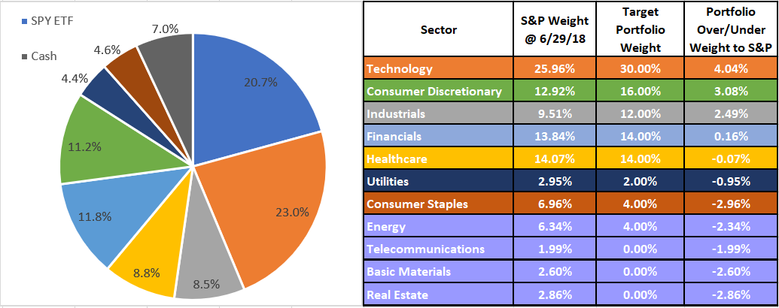
Portfolio Allocation @ 11/30/18
Notes:
statement?
already

Slide 9
Portfolio Performance @ 11/30/18

Slide 10
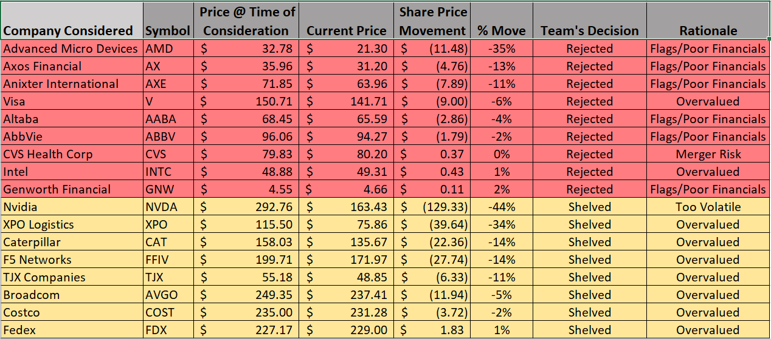
28 Total Considered Positions
Notes:
bold movement

Slide 11
Current Portfolio Holdings
Listed in Order of Purchase
~$1.4M Initially Invested in the 5 ETFs, ~$569k Initially Invested in Individual Stocks
Notes:
Bought ETF’s on 10/3, then made first individual stock purchase (BA) on 10/18
in the order of purchase time

Slide 12
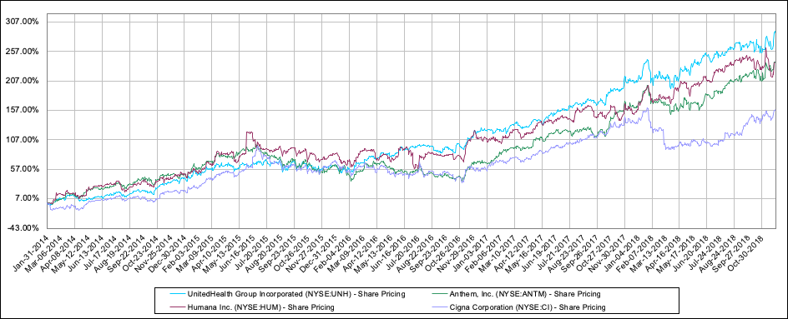
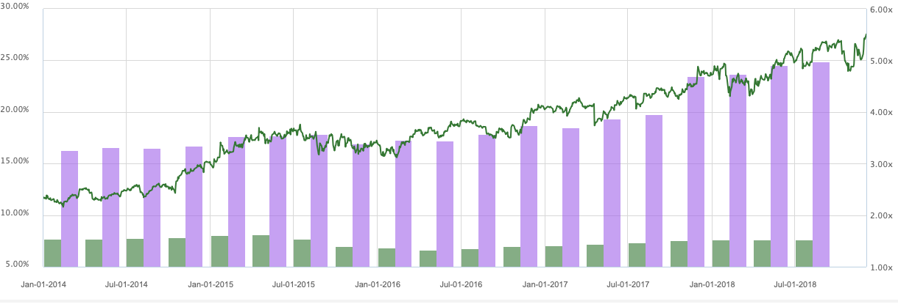
United Healthcare Group (UNH)
Stock Performance
Why choose UNH?
Word-of-mouth (Low Marketing cost)
Strong Financial statement
Diligence to clients
Innovator in the healthcare management industry
Future Outlook
Developing software for storing and analysing healthcare information ($ 7B)
New on-demand healthcare and new designs for the eligible and Medicare advantage participants hold promise for continued growth
Current P/B: 5.5 times Current ROE %: 25 Current EBIT margin %: 7.65
Notes:
Wise in dealing with policy changes in the last 5 years in the healthcare sector, specially changes that happened to ACA
As an international student, when I first came to this country and need a healthcare insurance to waive my student insurance, I didn’t know what choices I have. So I asked some senior chinese students for advice. They told me: “ You should buy United Healthcare’s medicare plan. Because it’s cheaper than what the university offers and it cover the cost of prescription, medicine and specially HPV vaccine, which is basiclly what we need in a short peirod.” So when I was assigned to pitch a stock from healthcare sector. This company showed up because of its good reputation in chinese international students group. I found out this company has been the leader in healthcare management industry for the last five years so it fits our investment philosophy. United healthcare stock performance has been doing great in the last 5 year as you can see in blue line compared to its competitors like cigna, Anthem and Humana. UNH has constantly growing earnings and better key ratios than its competitors. As you can see here, this graph, the green line is P/BV, it goes up. The bar in green is the EBIT margin. And the bar in purple is ROE. Optum is a segment under United healthcare Group who deliver care from healthcare providers to patients and clients in various way. The revenue generated from this segment has been growing rapidly year over year. In 2017, Optum accounted 32% of total sales. Optum has been working on developing software for storing and analysing healthcare information, which could help doctors to find the most effective treatment for patients while cutting down the cost. The estimated value of this digital market in is $ 7 B and UNH is absolutely a leader in this innovation trend. With the new on-demand healthcare and designs for the eligible and Medicare advantage participants which hold promise for continued growth, I believe investing in UNH will bring positive returns to our portfolio.

Slide 13
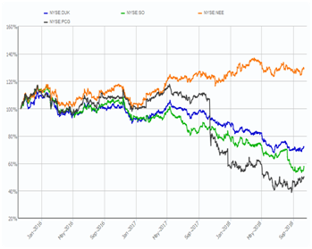
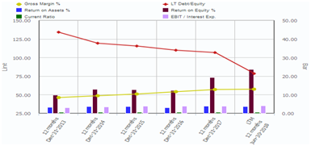
NextEra Energy (NEE)
Strengths:
Market Position: World leader in electricity generation from Renewable Resources..
Growth Plans: The company is building some of the lowest-cost universal solar ever.
Cost and Operational Efficiency: 15.6% inc in operating income). (Operating Margin 30.9%, to 28.5%).
Increase in Electricity Demand: Expected to increase to 3,924.4 TWh by 2022. Rise of electric vehicles will give impetus.
Salient Metrics:
P/E Ratio : 16.13(TTM) Net margin : 49.10%
Industry P/E : 27.54 Debt/Equity : 0.78
Notes:
Deals seen as immediately accretive to EPS ( $0.15 accretion in 2020 and $0.20 in 2021.)

Slide 14
Potential Risks
Position | Risks
Mastercard - MA | - Increasing regulations of certain aspects of payment - Limitations of ability to restrict merchant surcharging
NextEra Energy - NEE | - Natural disasters, particularly in Florida
PepsiCo - PEP | - Concerns over the long-term decline in soda sales and the corresponding drag on both revenue and earnings - Low potential for growth in mature markets
UnitedHealth Group - UNH | - Competition - Data security and privacy concerns - Changing regulations
Cognizant Technology Solutions - CTSH | - Intense competition from other service providers - Global operations subject to complex risks, beyond company control

Slide 15
Future Plans
Companies in the Pipeline for Pre-Authorization
Walt Disney (DIS), TJX Companies (TJX), Ball Corporation (BLL) Matson (MATX), Foot Locker (FL) and Pfizer (PFE)
Shelved Stocks for Reconsideration
CVS Health Corp (CVS), Nvidia Corp (NVDA), XPO Logistics (XPO) and Caterpillar (CAT)
Continue Working Toward 20 Individual Positions
Move Completely Out of the Sector ETFs
Re-Evaluate our Target Weighting Percentages,
IT, Consumer Discretionary, Healthcare and Telecommunications

Slide 16
Thank You!
December 6, 2018

