Slide 1


Slide 2

Fall 2018 Portfolio Report
December 6^{th,} 2018
By: Team Stamford

Slide 3
Introduction
Team Stamford
Christian Escotto-Rosado
Yuan Gao
Karthik Gurusamy
Sijie Hu
Jailian Li
Lindsey Lozyniak
Anshul Manglani
Chintan Shah
Di Yang
Fall Officers
Faculty Supervisors
Team Supervisor: Blake Mather
Fund Director: Dr. Chinmoy Ghosh
Co-Lead Managers: Anshul Manglani,
Communications Manager: Sijie Hu
Digital Media Manager: Lindsey Lozyniak
Di Yang

Slide 4
Agenda
Economic Overview
Sector Overview
Portfolio Performance
Q&A
Individual Holdings

Slide 5
Investment Philosophy
Objective
To outperform the S&P 500 over a 10+ year investment horizon by investing in undervalued companies
Philosophy
To invest long term in businesses that have a wide economic moat, excellent business model and a high Margin of Safety
Strategy
Managers will research their sectors to find companies with key competitive advantages and that foster long term value creation

Slide 6
Risk Management
Due Diligence
In depth research for each investment
Active follow-up on new information
Margin of Safety
Invest with a high margin of safety
Downside Protection
15-20% stop loss on all investments *
Diversification
Invest across all sectors
* Stop Loss on certain investments exceeds 20% to account for the historical volatility
Notes:
3minutes

Slide 7
ECONOMIC OUTLOOK

Slide 8
Economic Outlook – U.S.
GDP Growth
3.5% in Q3
Employment
UR at 3.7% for October
LFP at 62.9%
Consumer Confidence
CCI at 135.7
U of M consumer sentiment at 88.1
Inflation
Private Investment
2-2.5% in long-term
Average hourly earning growth at 3.2%
Headline CPI rose to 2.5%
Core CPI rose to 2.1%
Core PCE remained at 2%
8% increase in Q3
BCI at 100.64

Slide 9
Economic Outlook – Fiscal Development and Global Economy
U.S. Tax cut
$1.5 Trillion tax overhaul
Large benefit for U.S. corporations and reduce effective tax rate under 20%
Possible worsening fiscal deficit
Pulling demand forward in a late economic cycle
Trade Tensions
Uncertainty on trade and the actual effect of the tariff and retaliation in place
Increased input prices and lower corporate margins in the medium term
Effects differ from industry to industry
China Slow Down
A growth slow down and a deleveraging policy
Transformation of industry structure
Eurozone
Brexit uncertainty
Italy bond sell-offs
GDP growth at 2.2% and expected to slow down
Dollar Strength
Capital flow into U.S. with Treasury yield down and dollar strengthening
Notes:
2 minutes

Slide 10
SECTOR OVERVIEW

Slide 11
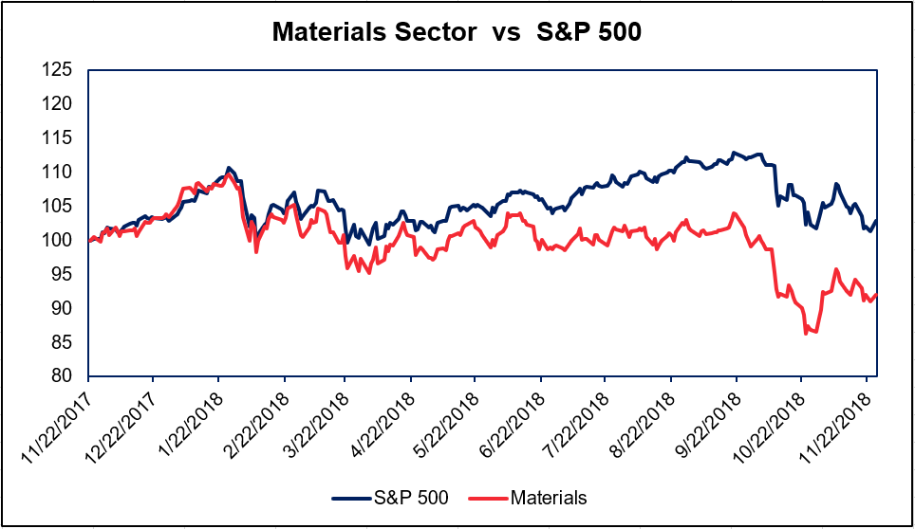
Basic Materials
Performance
- Underperformed S&P 500 over LTM
Industry Outlook
- Global trade concerns
- Structural change in demand growth
from China
Risks
- Global trade tensions
- Strong Dollar
- Weak demand for consumer durable goods
- Rising input costs
Current Holdings : International Flavors and Fragrances (IFF)

Slide 12
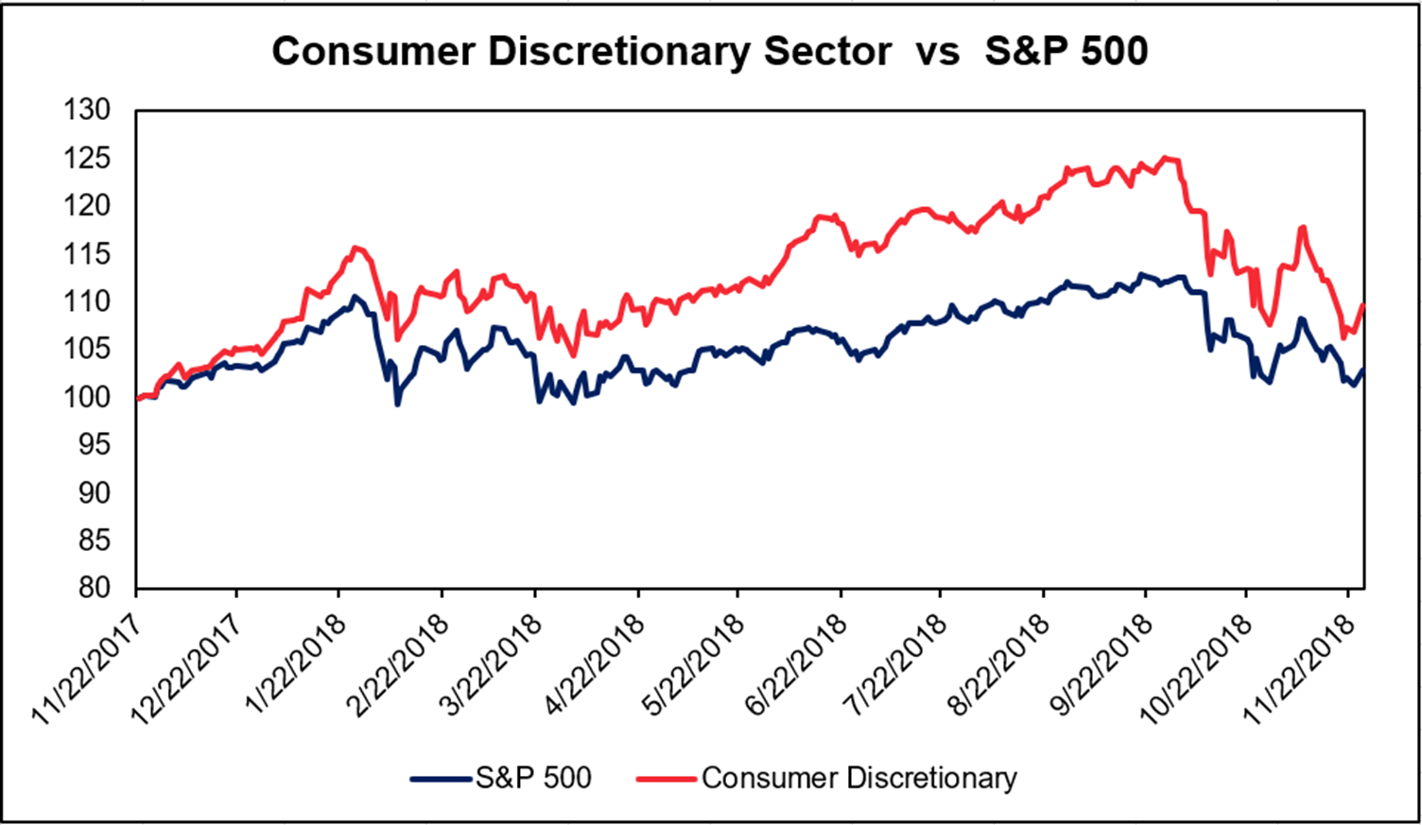
Consumer Discretionary
Performance
- Outperformed S&P 500 over LTM
Industry Outlook
- Continued wage growth in the US
- Improving overall job market
Risks
- Rising costs due to trade disputes
- Lower margins due to competition
Current Holdings : McDonald’s (MCD)
Notes:
https://www.schwab.com/resource-center/insights/content/consumer-discretionary-sector

Slide 13
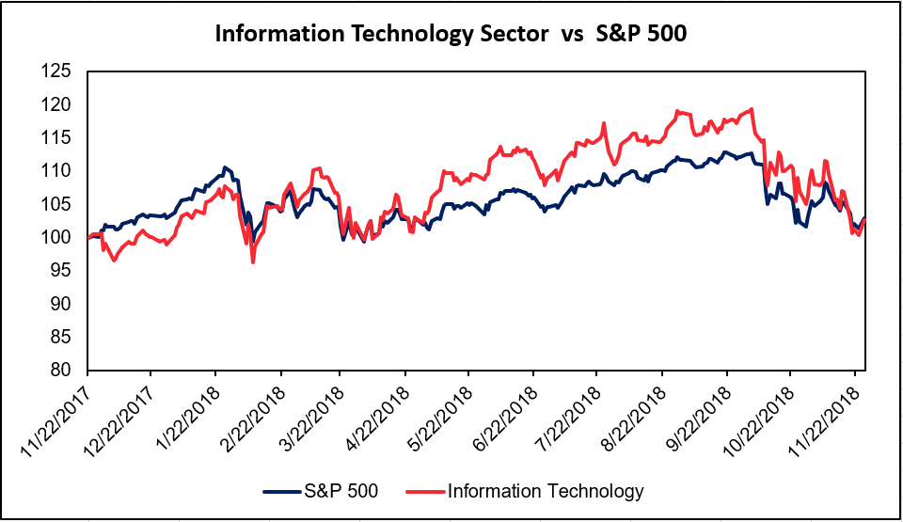
Information Technology
Performance
- Outperformed S&P 500 over LTM
Industry Outlook
- Main drivers: Cloud Computing, AI, IoT
- More organized and mature with a slew of . mergers and acquisitions
- Strong balance sheets
Risks
- Global trade tensions
- Increasing global competition
- Increased regulation
Current Holdings : Microsoft (MSFT)

Slide 14
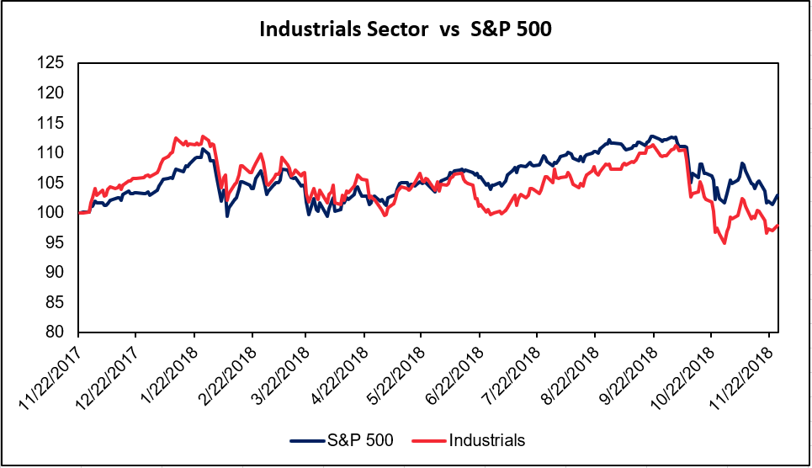
Industrials
Performance
- Underperformed S&P 500 over LTM
Industry Outlook
- Strong economic growth
Risks
- U.S. dollar strength could hurt exports
- Global trade tensions
- Uncertain fiscal spending
- New entrants in low barrier segments
Current Holdings : The Boeing Company (BA)

Slide 15
PORTFOLIO PERFORMANCE

Slide 16
Portfolio Allocation
Portfolio Allocation
Sector Allocation
Objective
* The chart above illustrates the portfolio allocation based on the market value of the securities as of November 30, 2018.

Slide 17
Portfolio Performance
Objective
* The table above depicts the portfolio performance as of November 30, 2018

Slide 18
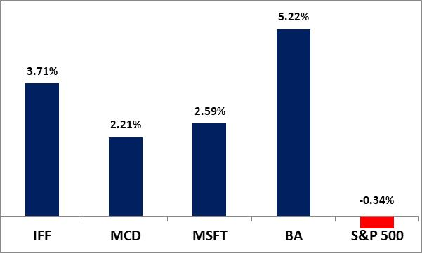
Portfolio Performance (Contd.)
Total Portfolio Unrealized Gains
Objective
* The graph above depicts the unrealized gains from our equity portfolio as of November 30, 2018.

Slide 19
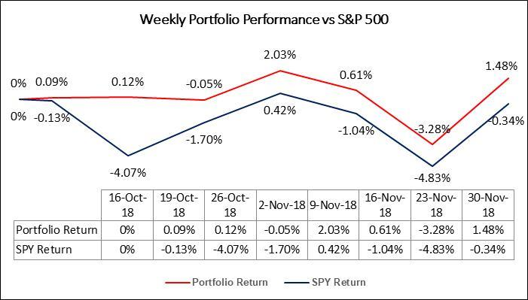
Portfolio Performance (Contd.)
Below is the weekly performance of our total portfolio vs S&P 500.

Slide 20
Portfolio Performance (Contd.)
Notes:
Portfolio: annualized standard deviation 14.24% 20.52% (SP500)
annualized return 12.94% 4.80% (SP500)
annualized covariance 2.11%
beta 0.5016
sharpe ratio 0.72 0.10(SP500)
treynor ratio 0.20 0.02(SP500)

Slide 21
Portfolio Performances (Contd.)
Objective
*This is for drawing an easier comparison with the other SMF teams' performance. This is not to inflate our past performance.

Slide 22
INDIVIDUAL HOLDINGS

Slide 23

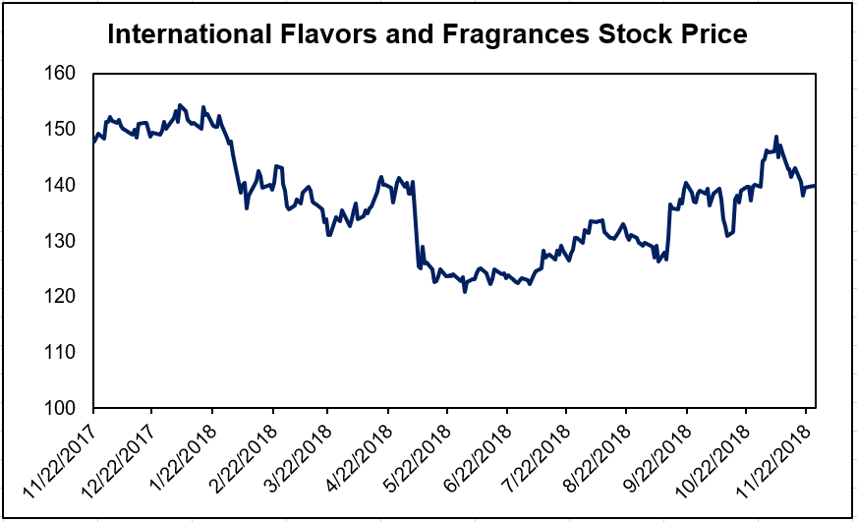
International Flavors and Fragrances
Basic Metrics
Basic Metrics
Purchase Price | $136.57
Current Price | $141.63
52 Week High | $157.4
52 Week Low | $122.11
Market Capitalization | $15.1 (B)
Dividend Yield | 2.04%

Slide 24
International Flavors and Fragrances
Investment Thesis and Risks
Thesis
Risks
Wide Economic Moat
  Proprietary Formulations (highly valuable intangible assets)
  R&D spending is 8% of sales
  Widespread acceptance on customer core lists
Vision 2020 Strategy
  Differentiation and Accelerating Growth
Frutarom Acquisition
  IFF and Frutarom combination creates a global leader in natural taste, scent and nutrition
Disruption in manufacturing operations or in the supply chain
Currency fluctuation or devaluation in the international markets
Failure to comply with environmental protection laws
Frutarom integration

Slide 25

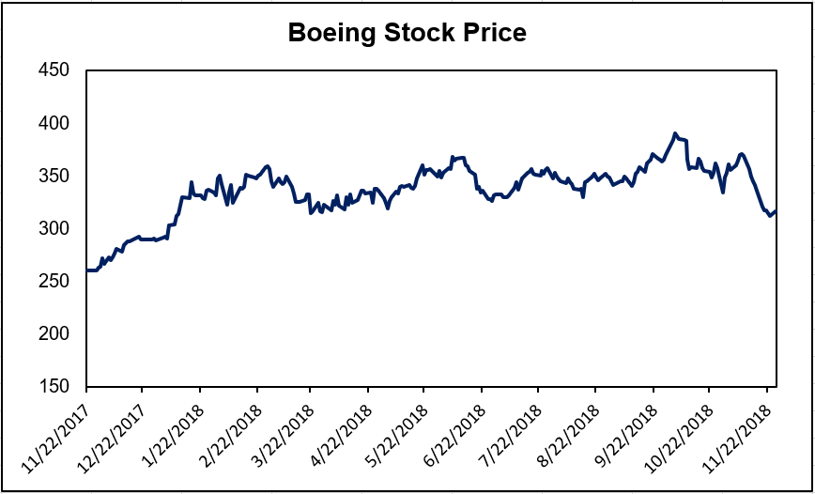
The Boeing Company
Basic Metrics
Basic Metrics
Purchase Price | $329.5486
Current Price | $346.76
52 Week High | $394.28
52 Week Low | $260.15
Market Capitalization | $209.74 (B)
Dividend Yield | 1.92%

Slide 26
The Boeing Company
Investment Thesis and Risks
Thesis
Risks
Wide Economic Moat
  Highly regulated industry with high technology requirement
  Long-term defense contracts and strong government relation
Healthy Business
  Outstanding operating cash flow and liquidity with manageable debt level
Robust Backlog orders signal strong revenue growth
  Year to Date, total backlog orders valued at $491 B, 7 years of production.
U.S. Dollar strengthening
Trade tension with China
Uncertainty in fiscal appropriations
Possible failure in new programs

Slide 27


Lessons Learned
Hard Skills
Soft Skills
Valuation/Modeling
Stock Screening/Advanced Bloomberg Functions
Industry Expertise
Macroeconomic Knowledge
Presentation Skills
Teamwork
Second Level Thinking
Behavioral Finance
High standards and rigorous training for managing a real fund

Slide 28
Q&A

Slide 29
APPENDIX

Slide 30
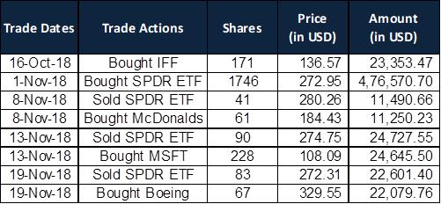
Transactional Details

Slide 31
Investment Process
Divide Sectors
Our team divides the S&P 500 amongst ourselves so that every analyst is covering at least 2 sectors
Research & Pitch
Analysts are tasked with using quantitative and qualitative criteria to find strong investment opportunities and prepare a short report and slide deck explaining their reasoning for the investment
Vote
For an investment with 9/9 favorable votes, 100% of the proposed position size will be allocated
Follow-up
Closely follow up with information relevant to our investments and input variables in our models
For 8/9 favorable votes, 90% of the proposed position size will be allocated
For 7/9 favorable votes, 80% of the proposed position size will be allocated
Adjust our position size based on new information

Slide 32

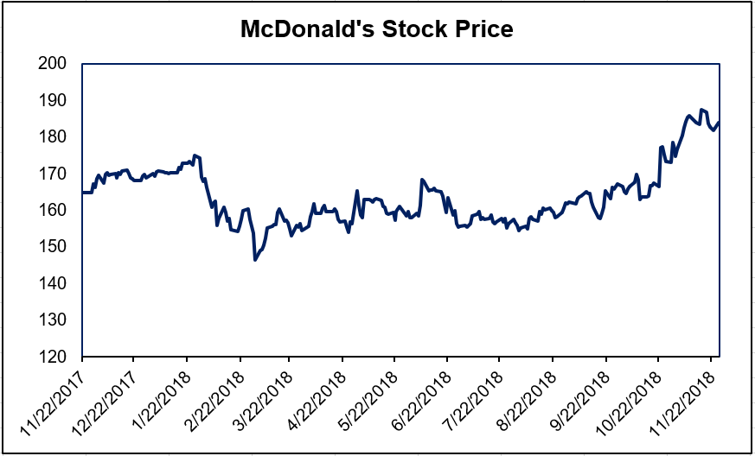
McDonald’s
Basic Metrics
Basic Metrics
Purchase Price | $184.43
Current Price | $188.51
52 Week High | $183.91
52 Week Low | $146.84
Market Capitalization | $141.5(B)
Dividend Yield | 2.77%

Slide 33
McDonald’s
Investment Thesis and Risks
Thesis
  Experience of the Future (EOTF) and Delivery
  Order accuracy, and customer satisfaction scores increase continually.
  Cost Reduction
  Cooperating with Uber Eats Delivery increased US same-store sales by 3%.
  Franchisee System.
  MCD owns 45% of the land, and 75% of the buildings for its restaurants.
  Becoming a nimbler organization
  MCD always make decisions at the local and regional level.
  The Dividend Yield of MCD is attractive
  MCD has been increasing dividend for 41 years
Risks
Potential decrease in U.S. consumer confidence index and weak customer response to new menu offerings.
Uncertainty of the trade discussions will hit the markets, and result in fluctuations in food costs, competitive discounting and exchange rate volatility.
MCD is sensitive to economic fluctuations across the globe, including currency movements, and negative publicity tied to food quality concerns.

Slide 34

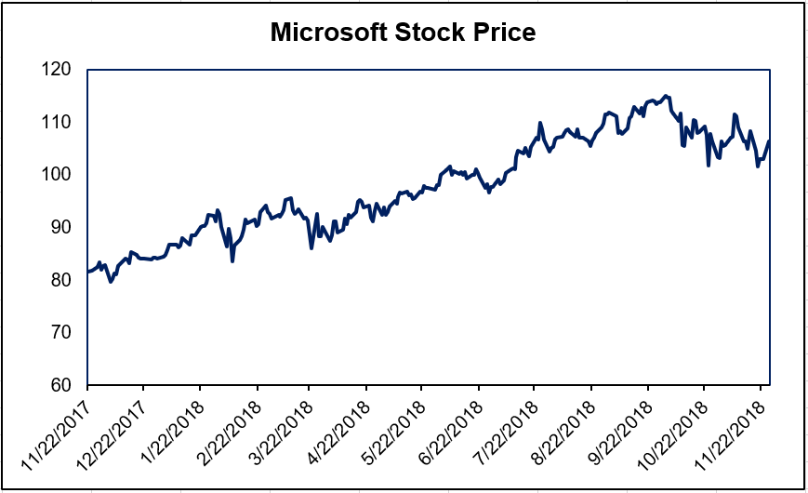
Microsoft
Basic Metric
Basic Metrics
Purchase Price | $ 108.12
Current Price | $ 110.89
52 Week High | $ 116.18
52 Week Low | $ 80.70
Market Capitalization | $ 851.2 (B)
Dividend Yield | 1.7%

Slide 35
Microsoft
Investment Thesis and Risks
Thesis
Risks
Wide Economic Moats
  Dominant Market Share among Operating Systems and Office Tools
  Acceleration in Cloud Services growth
  Diversified Clientele
Rapid Development in Cloud Computing industry
Acquisitions and Partnerships
  Expand partnerships with many large companies on cloud computing, AI and IoT to capture global market
  Crucial synergy of the LinkedIn and GitHub
Significant investments in new products and services may not achieve expected returns
Government litigation and regulatory activity may limit how Microsoft designs and markets its products
Cyberattacks and security vulnerabilities
Acquisitions like GitHub may face an overpayment risk

