Slide 1
University of Connecticut MBA SMF Presentation
December 9th 2015
Akhil Sood, Akhilesh Kumar, Alex Sadowski
Christopher Norris, Edward Laclaustra, Jason Harris,
Jifeng Hu, Lingfan Sun, Neel Munot, Yun Xie
,,

Slide 2
Agenda
Investment Philosophy and Strategy
Process & Procedure
Risk Management
Economic Outlook
Portfolio Analysis
Performance
Selected Holdings
Investment Philosophy and Strategy
Process & Procedure
Risk Management
Economic Outlook
Portfolio Analysis
Performance
Selected Holdings

Slide 3
Investment Philosophy and Style
Value Investing
Emphasis on Fundamental Analysis
5-Year Investment Horizon
Corporate Social Responsibility
Investment Philosophy and Strategy
Process & Procedure
Risk Management
Economic Outlook
Portfolio Analysis
Performance
Selected Holdings

Slide 4
Investment Strategy
Bottom-Up Investment Approach
35-40 Stocks When Fully Invested
4 Stock Pitches Per Investment Manager
Currently Invested in 17 Stocks (~46% Invested)
No Bond Investment
Investment Philosophy and Strategy
Process & Procedure
Risk Management
Economic Outlook
Portfolio Analysis
Performance
Selected Holdings

Slide 5
Process & Procedure
Training and development
Communication
Stock pitch
Voting
Tracking
Investment Philosophy and Strategy
Process & Procedure
Risk Management
Economic Outlook
Portfolio Analysis
Performance
Selected Holdings

Slide 6
Risk Management
Business Model Risk
Stable and easily understanding business model
Balance Sheet Risk
Strong balance sheet and financial reports
Macro Economic/ Social Responsibility
Above average CSR scores
Aggregation Risk
Allocate stock in all 10 sub sectors
20% stop loss order
Investment Philosophy and Strategy
Process & Procedure
Risk Management
Economic Outlook
Portfolio Analysis
Performance
Selected Holdings

Slide 7
Economic Outlook
Global growth forecast at 3.3% in 2015 and 3.8% in 2016
Forces are now more redistributive in nature:
Sharp declines in oil prices
Diverging trajectories of the major economies
Strengthening of the U.S. dollar and the weakening of the euro and yen
Outlook for advanced economies is showing signs of improvement
Disposable incomes from lower oil prices
Accommodative monetary policy
Growth in emerging market economies is softening
Adjustment to diminished medium-term growth expectations
Lower revenues from commodity exports
Investment Philosophy and Strategy
Process & Procedure
Risk Management
Economic Outlook
Portfolio Analysis
Performance
Selected Holdings

Slide 8
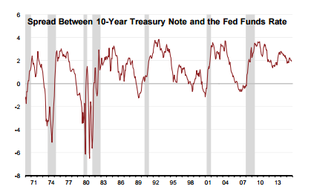
Economic Outlook - US
U.S. economy is in the middle of what could turn out to be the longest expansion
Leading economic indicators point towards mid cycle position
Yield Curve
Investment Philosophy and Strategy
Process & Procedure
Risk Management
Economic Outlook
Portfolio Analysis
Performance
Selected Holdings
Charts Source: Bank of America Capital Markets Outlook http://corp.bankofamerica.com/documents/16307/0/capital_market_outlook.pdf

Slide 9
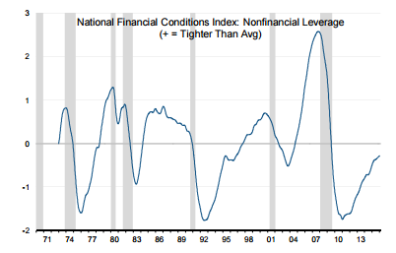
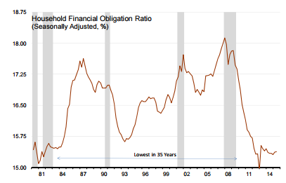
Economic Outlook - US
Leverage & household obligation
Investment Philosophy and Strategy
Process & Procedure
Risk Management
Economic Outlook
Portfolio Analysis
Performance
Selected Holdings

Slide 10
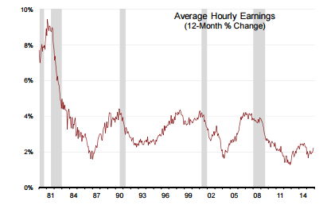
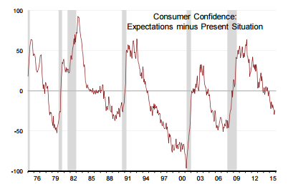
Economic Outlook - US
Wages & Consumer Confidence
Investment Philosophy and Strategy
Process & Procedure
Risk Management
Economic Outlook
Portfolio Analysis
Performance
Selected Holdings

Slide 11
Portfolio Status I :17 Stocks
Investment Philosophy and Strategy
Process & Procedure
Risk Management
Economic Outlook
Portfolio Analysis
Performance
Selected Holdings

Slide 12
Portfolio Status II : Return
Investment Philosophy and Strategy
Process & Procedure
Risk Management
Economic Outlook
Portfolio Analysis
Performance
Selected Holdings

Slide 13
Portfolio Analysis: Sector Allocation
Investment Philosophy and Strategy
Process & Procedure
Risk Management
Economic Outlook
Portfolio Analysis
Performance
Selected Holdings

Slide 14
Portfolio Analysis: Positions
Industry | Company | Date Purchased | Shares Held | Current Price | Portfolio Weight | Current Position Value
Consumer Discretionary |  |  |  |  | 23.5% | 201,182
Leisure Products | Polaris | 29-Oct-15 | 450 | 105.73 | 5.9% | 47,601
Media & Entertainment | Disney | 29-Oct-15 | 435 | 119.42 | 5.8% | 50,195
Household Durables | Toll Brothers | 29-Oct-15 | 1400 | 37.10 | 5.9% | 53,284
Specialty Retail | Carmax | 6-Nov-15 | 875 | 56.63 | 5.9% | 50,103
Consumer Staples |  |  |  |  | 11.9% | 101,809
Food & Staples Retailing | CVS Health | 17-Nov-15 | 535 | 91.56 | 5.9% | 51,066
Tobacco | Reynolds American | 19-Nov-15 | 1100 | 47.03 | 6.0% | 50,743
Energy |  |  |  |  | 5.9% | 53,406
Oil, Gas & Consumable Fuels | Marathon Petroleum | 19-Nov-15 | 900 | 56.41 | 5.9% | 53,406
Financials |  |  |  |  | 11.8% | 104,577
Consumer Finance | Capital One | 18-Nov-15 | 650 | 78.82 | 5.9% | 51,883
Real Estate Investment Trusts | AvalonBay | 19-Nov-15 | 285 | 181.50 | 5.9% | 52,694
Health Care |  |  |  |  | 11.6% | 98,423
Biotechnology | Gilead Science | 6-Nov-15 | 460 | 106.36 | 5.8% | 48,691
Health Care Equ & Sup | Medtronic | 11-Nov-15 | 650 | 76.56 | 5.8% | 49,732
Industrials |  |  |  |  | 11.6% | 98,452
Aerospace & Defense | UTX | 29-Oct-15 | 500 | 98.09 | 5.8% | 48,350
Air Freight & Logistics | UPS | 6-Nov-15 | 480 | 103.59 | 5.8% | 50102.4
Information Technology |  |  |  |  | 6.0% | 51,630
Tech Hard, Storage & Periph | Apple Inc | 18-Nov-15 | 440 | 117.75 | 6.0% | 51,630
Materials |  |  |  |  | 5.9% | 50,989
Construction Materials | Martin Marietta | 18-Nov-15 | 320 | 159.92 | 5.9% | 50,989
Telecommunication Services |  |  |  |  | 5.9% | 50,655
Diversified Telecomm Services | AT&T | 19-Nov-15 | 1500 | 33.46 | 5.9% | 50,655
Utilities |  |  |  |  | 6.0% | 58,652
Electric Utilities | ITC Holding | 19-Nov-15 | 1,550.0 | 33.30 | 6.0% | 58,652
Investment Philosophy and Strategy
Process & Procedure
Risk Management
Economic Outlook
Portfolio Analysis
Performance
Selected Holdings

Slide 15
Portfolio Analysis (Invested Portfolio): Statistics
 | SMF Portfolio | S&P 500 | Difference
Dividend Yield | 1.91 | 2.09 | -0.18
Price to Earning | 16.30 | 18.66 | -2.36
Price to Cash flow | 12.29 | 10.90 | 1.39
EV/Sales | 2.07 | 2.22 | -0.15
EV/EBITDA | 11.12 | 12.68 | -1.56
Profit Margin | 9.10 | 8.32 | 0.78
Return on Assets | 4.85 | 2.72 | 2.13
Beta | 0.96 | 1.00 | -0.04
Investment Philosophy and Strategy
Process & Procedure
Risk Management
Economic Outlook
Portfolio Analysis
Performance
Selected Holdings

Slide 16
Portfolio Performance: Individual Returns
Investment Philosophy and Strategy
Process & Procedure
Risk Management
Economic Outlook
Portfolio Analysis
Performance
Selected Holdings

Slide 17
Portfolio Performance: Invested Portfolio
Portfolio Statistics | SMF Invested Portfolio | S&P 500
› Return
Total Return | 1.54 | 0.88
Mean Return (Annualized) | 28.73 | 16.21
Mean Excess Return (Annualized) | 10.78
› Risk
Standard Deviation (Annualized) | 12.28 | 12.18
Downside Risk (Annualized) | 8.48 | 7.90
› Risk/Return
Sharpe Ratio | 1.60 | 0.92
Jensen Alpha | 8.98
Information Ratio | 1.88
Investment Philosophy and Strategy
Process & Procedure
Risk Management
Economic Outlook
Portfolio Analysis
Performance
Selected Holdings

Slide 18
Portfolio Performance: Total Portfolio
 | Sep 22, 2015 | December 1, 2015
ETF | 1,860,328.77 | 1,146,099
Equity | - | $869,774
Cash | 327 | $8,067
Total | 1,860,655.77 | $2,023,940
Return | 8.78%
Investment Philosophy and Strategy
Process & Procedure
Risk Management
Economic Outlook
Portfolio Analysis
Performance
Selected Holdings

Slide 19
Worst Performing Stocks: Polaris
Consumer Discretionary: Leisure Products
Unrealized Loss of 5.3%
Reason for Underperformance
Strong Dollar, softening economies abroad
Sluggish Oil and Agricultural Markets
Constraints for fast growing motorcycle business
Future Outlook
Zacks Rating: 1.85 (1-Buy, 5-Sell) 12/3/15
Operational Constraints Lifted
Taking market share from Harley Davidson
New ORV Mfg Facility, JV for Emerging Markets
Investment Philosophy and Strategy
Process & Procedure
Risk Management
Economic Outlook
Portfolio Analysis
Performance
Selected Holdings
Notes:
Huge Growth in Motorcycle Market
New AL Plant, New Indian and Slingshot Motorcyle Brand
Mgmt reduced Earnings Growth Estimates to 11-12% vs mid-20% last 5 years
Eicher Joint Venture
Polaris established a 50/50 joint venture with Eicher Motors Limited (OTC:ECQRY) in 2012 to design, develop and manufacture a full range of new vehicles for India and other emerging markets.
Off-Road Vehicle "ORV" Greenfield Facility
Polaris is currently building a new Greenfield facility, primarily for the ORV segment of the business, in Huntsville, Alabama. Work on this facility began in June of 2015 and is expected to be completed and ready for production in Q2 of 2016.
Polaris is a high-quality company that has a history of being conservatively run, which has resulted in positive ratings from both Morningstar and S&P. Morningstar has given the company a "wide" economic moat and a "strong" financial health ratings, although it also gives a "high" uncertainty rating due to concerns of high industry inventory and shaky global consumer confidence.
Meanwhile, S&P gives the company an "A" quality ranking as well as an S&P Investability Quotient Ranking of 96%. The company does not have an S&P credit rating, but has a reasonable debt/cap ratio of just 24% and debt/equity ratio of 34%.

Slide 20
Best Performing Stock: ITC Holding
Consumer Discretionary: Leisure Products
Unrealized gain of 14.7%
Reason for over performance
Exploring sale options
Sole U.S. Transmission only company
Future Outlook
Generate a lot of interest from infrastructure funds
Utility M&A are up among weaken electricity sales
FERC Judge to decide on ROE reduction in Mid-Dec
Investment Philosophy and Strategy
Process & Procedure
Risk Management
Economic Outlook
Portfolio Analysis
Performance
Selected Holdings
Notes:
U.S./Canadian utility deals
Some utility companies in Canada and the United States such as Southern Co. and Duke Energy Corp are buying utilities with potential growth amid the weakening of electricity sales. Nearly 30 utility transactions have been announced in both countries this year. The total value of the announced deals was approximately $44 billion based on data compiled by Bloomberg.
Customers requested the FERC to reduce the allowed return on equity for the company. A Commission’s chief administrative law judge is expected to decide on the request in the middle of December.

Slide 21
Acknowledgements
Dr. Chinmoy Ghosh
Dr. Michel Rakotomavo
Laurel Grisamer
Chris Wilkos
Investment Advisory Board Members
UConn Foundation

Slide 22
Q&A
Thank You

Slide 23
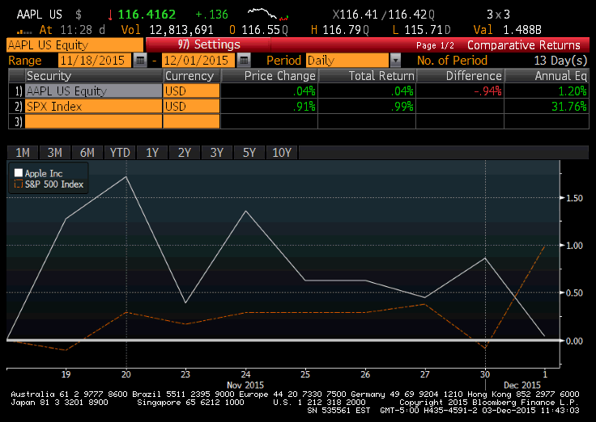
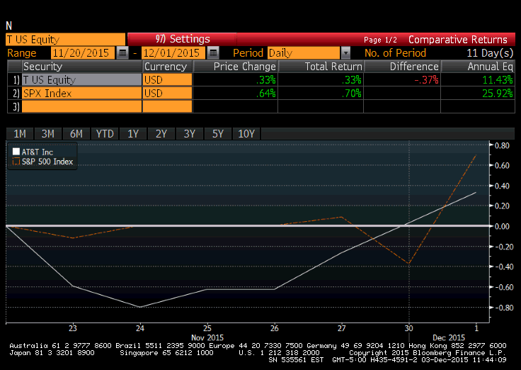
Stock/S&P 500 Comparison
AAPL
AT&T

Slide 24
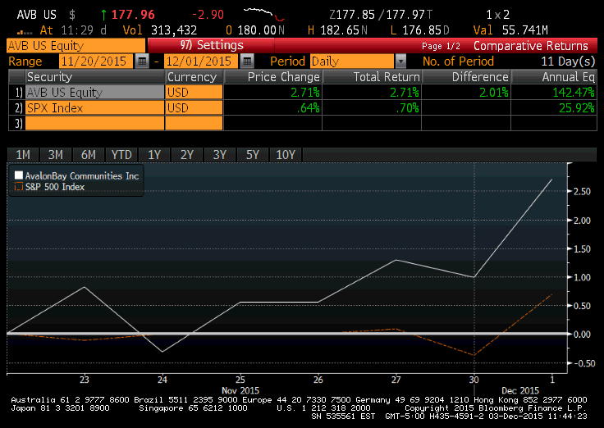
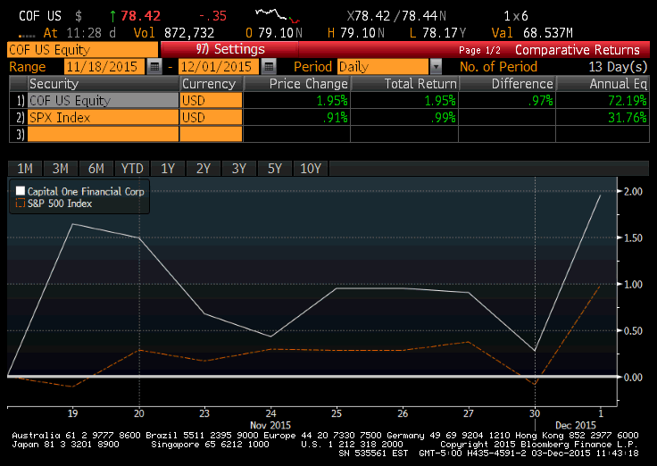
Stock/S&P 500 Comparison
AVB
COF

Slide 25
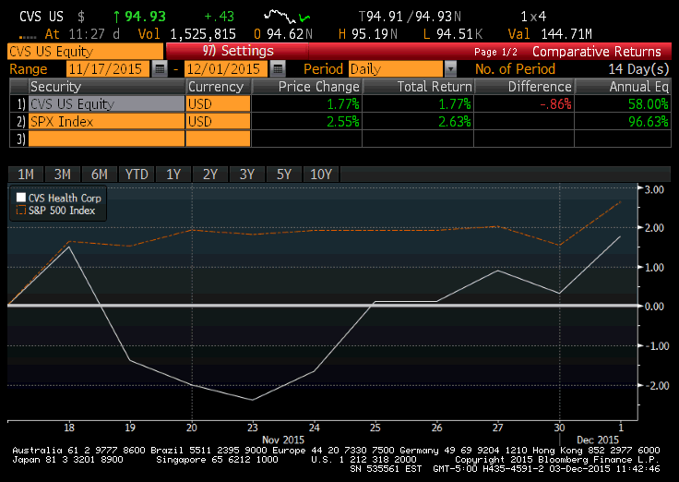
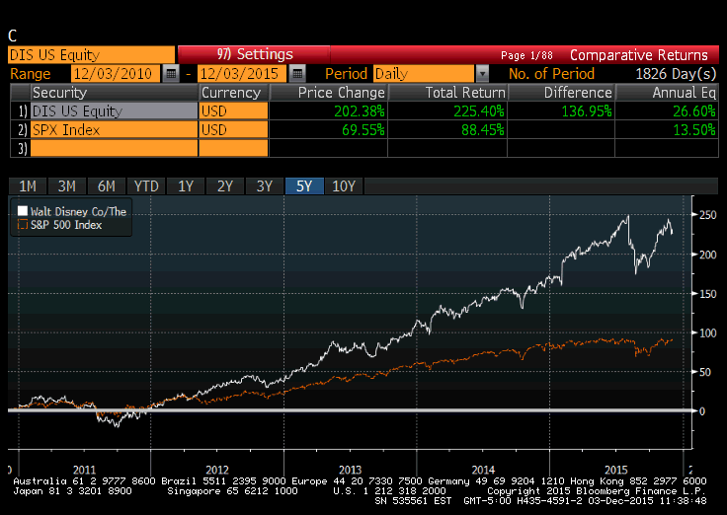
Stock/S&P 500 Comparison
CVS
DIS

Slide 26
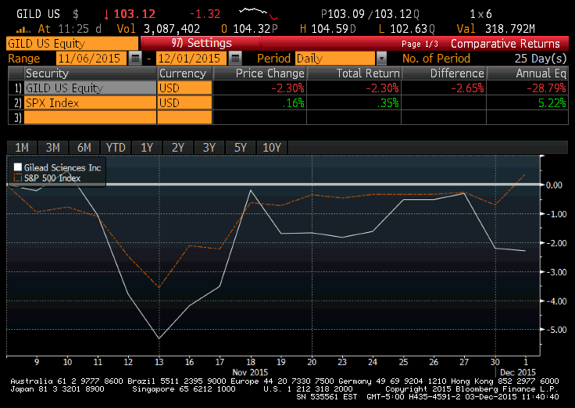
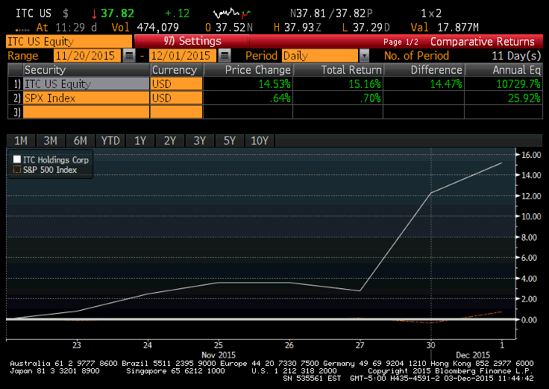
Stock/S&P 500 Comparison
GILD
ITC

Slide 27
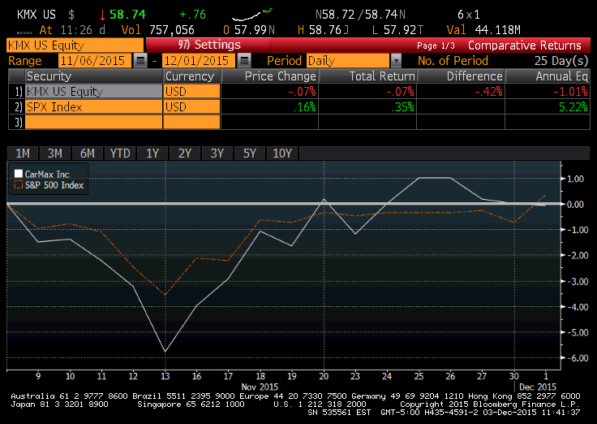
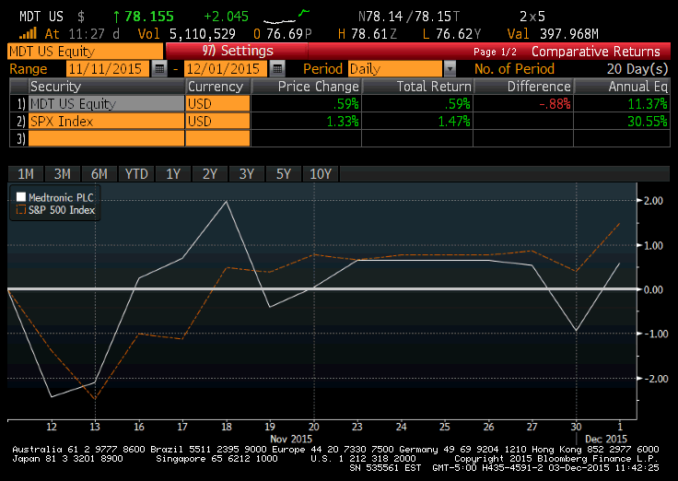
Stock/S&P 500 Comparison
KMX
MDT

Slide 28
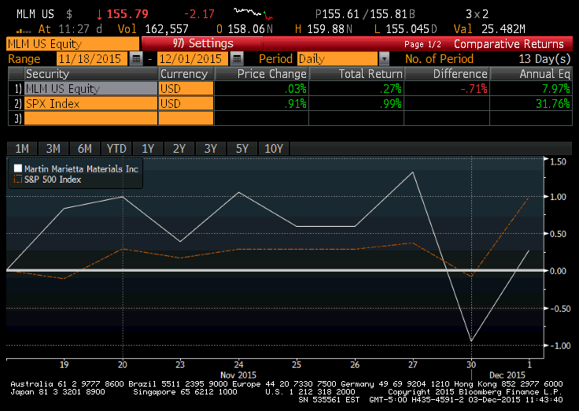
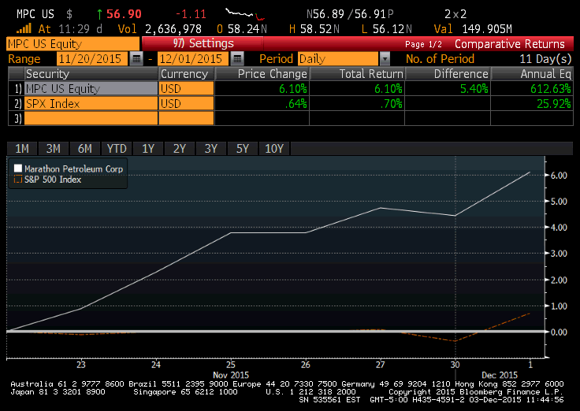
Stock/S&P 500 Comparison
MLM
MPC

Slide 29
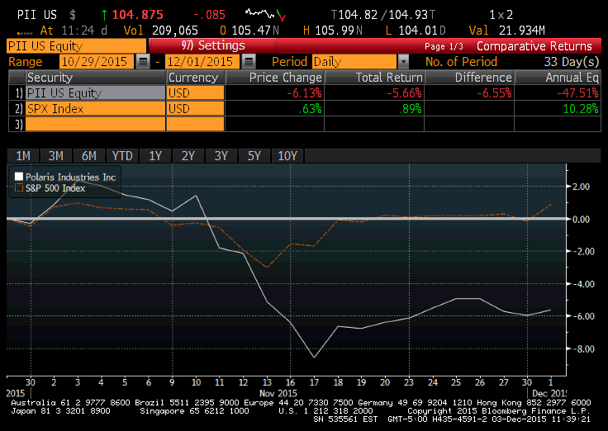
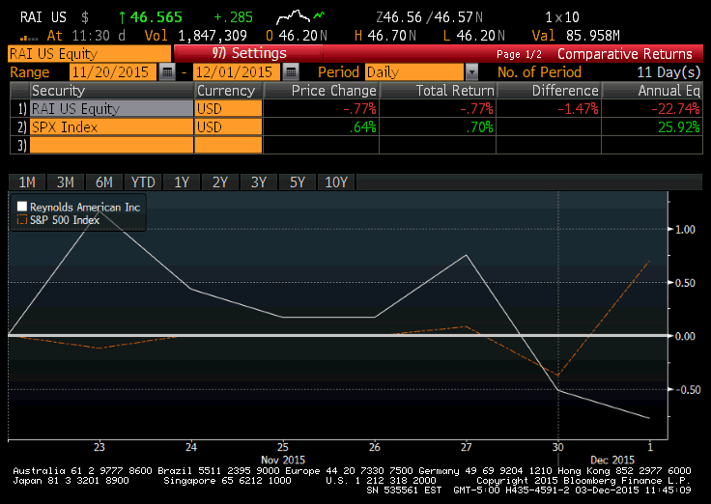
Stock/S&P 500 Comparison
PII
RAI

Slide 30
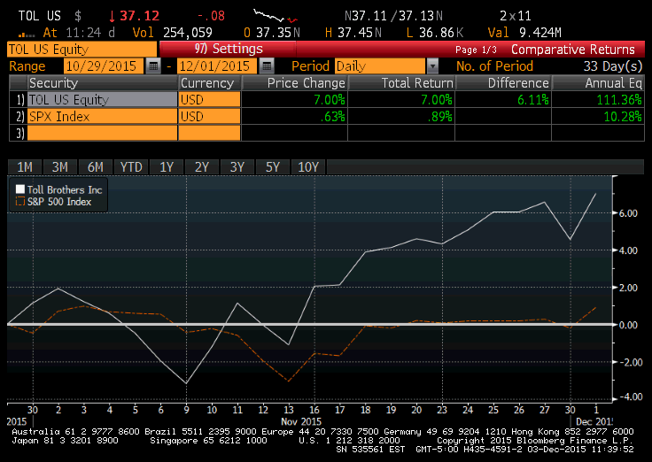
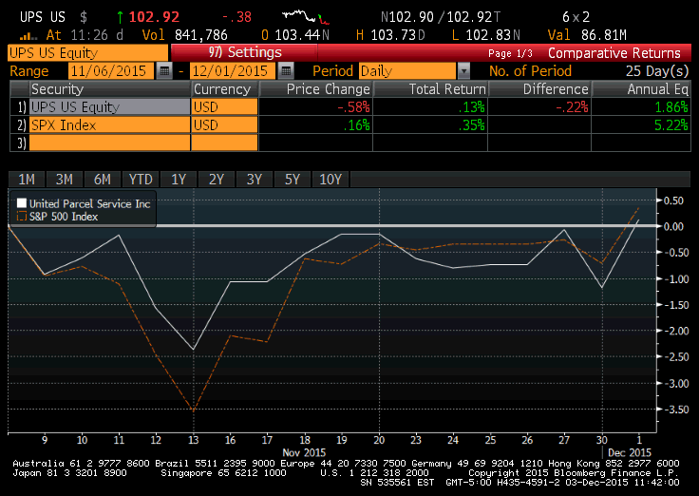
Stock/S&P 500 Comparison
TOLL
UPS

Slide 31
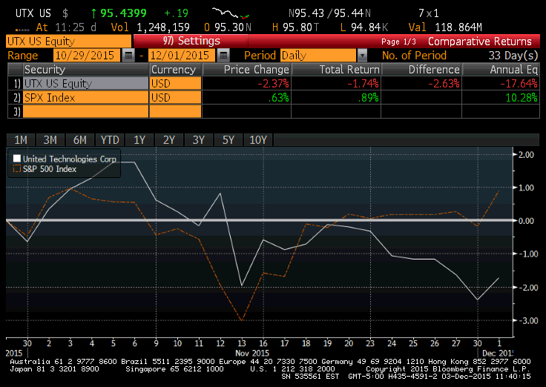
Stock/S&P 500 Comparison
UTX

